Slide 1
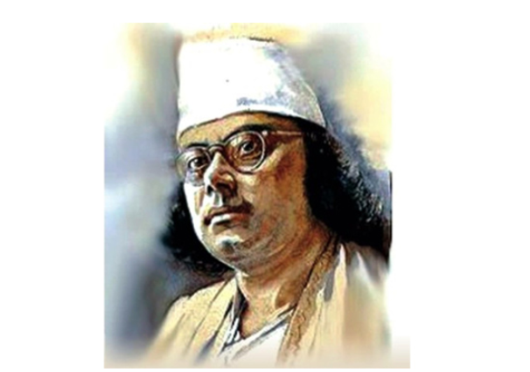




Slide 2




Slide 3


Slide 4



Slide 5
Bengali Music Genre
Rabindra Sangeet
Nazrul Sangeet
Lalon Geeti
Adhunik
Band
Hip Hop

